Slide 1
Plotting with MatPlotLib
Hydroinformatics, Dr. Dan Ames

Slide 2
Source for our Plot Examples:
http://matplotlib.org/gallery.html

Slide 3
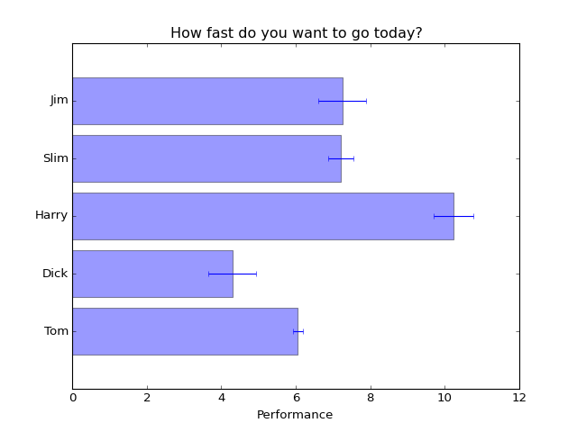
Bar Plot
Change the names
Change the colors
Change the values
Change the labels
Change the title
What kind of data would we represent this way from ODM?

Slide 4
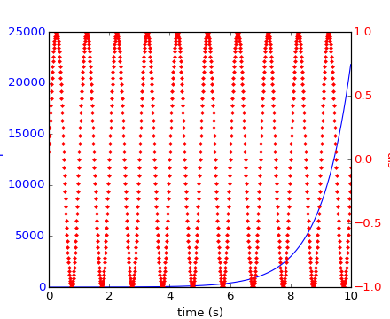
Plotting with two scales
Change the axis labels
Change the values
Can you plot temperature and dissolved oxygen on the same plot?

Slide 5
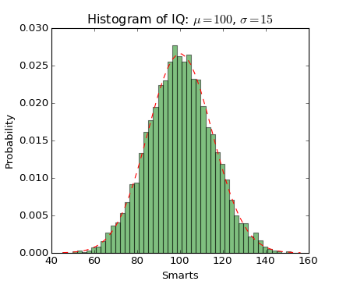
Histogram
Change the axis labels
Change the data
Change the color?
Change the title?
What could you plot from your ODM?

Slide 6
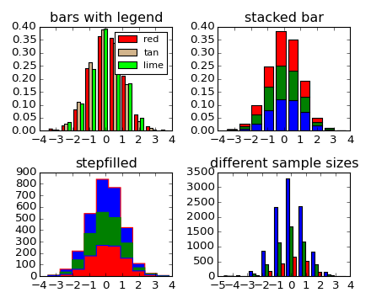
Multi Plot - Histogram
Change the titles
Change the data
Change the colors
What is the value of a multiple plot like this?

Slide 7
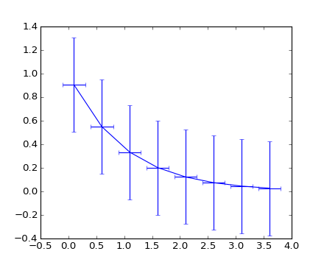
Error Bars
Try changing the data
Add a title
Make it a multiplot!
Add axis labels!
What information from ODM could we present this way?

Slide 8
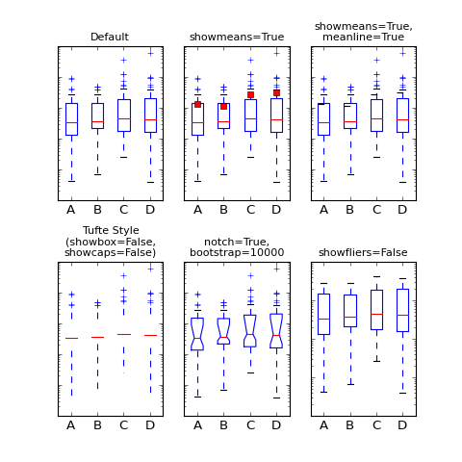
Box & Whiskers Plot
Change the data
Change the labels
Change the markers
Change the styles
What kind of info from ODM could/should we represent this way?

Slide 9

You Pick One!
What is it?
How can you modify it?
What hydro data can you represent?

